Slide 1
What is the climate like in Mediterranean part of Croatia?
Winters are cold and snowy and summers are rainy
Winters are snowy and summers are hot and dry
Winters are mild and rainy and summers are hot and dry
Winters are mild and rainy and summers are mild as well

Slide 2
2. What kind of soil do mushrooms grow in?
Wet soil
Dry soil
Fertile soil
Stony soil

Slide 3
3. Circle the correct answer about lichens (two answers are correct)
Lichen is relationship between algae and mushrooms
Lichen is relationship between algae and moss
Lichens are very sensitive to air pollution
They can be found in polluted areas

Slide 4
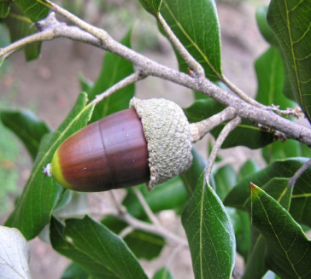
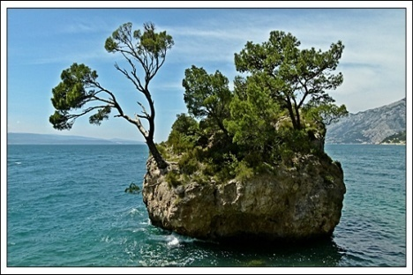
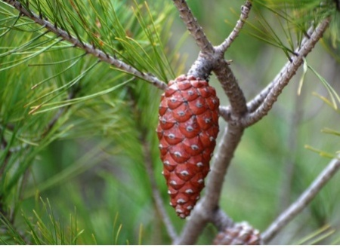
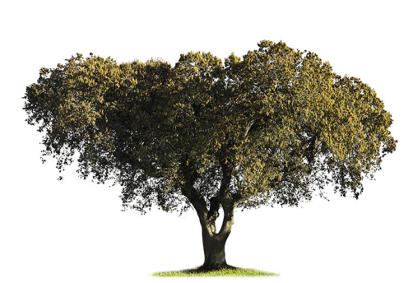
4. Connect
A
B
C
D
1 - HOLM OAK TREE
2 - PINE
A1
B2
C2
D1

Slide 5
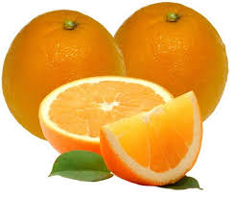
5. Guess who am I?
I am sour-sweet citrus, rich source of vitamin C. Who am I?
ORANGE

Slide 6
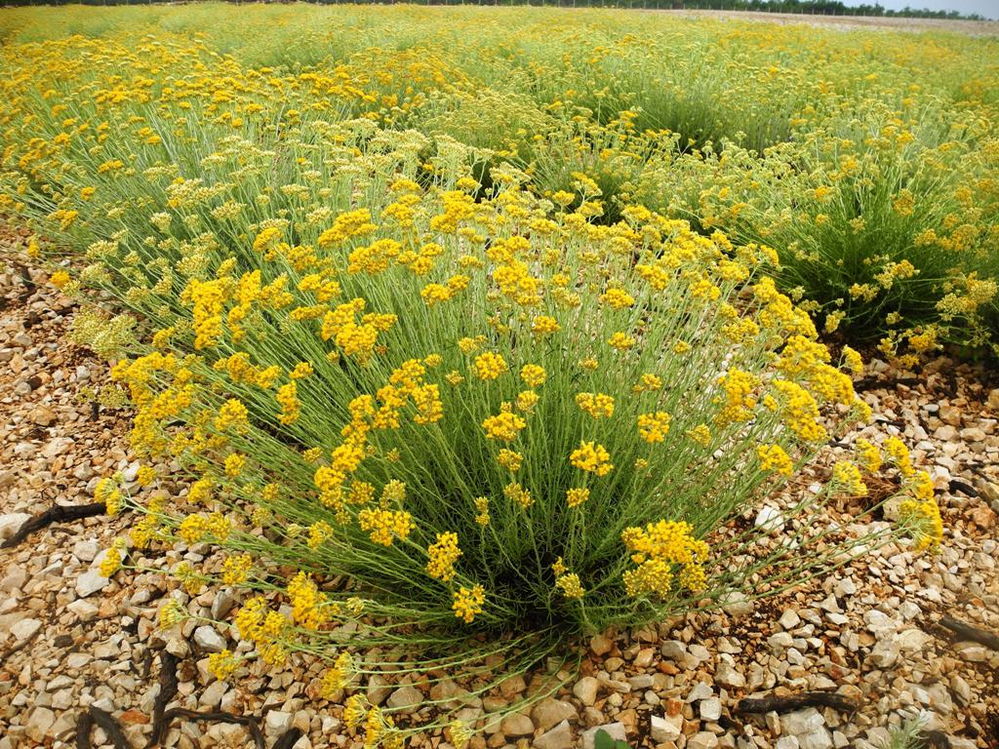
For one litre of my oil you will need a tonne of fresh flowers. Who am I?
IMMORTELLE

Slide 7
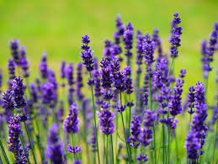
My fresh, floral scent can make you feel calm.
Who am I?
LAVANDER

Slide 8
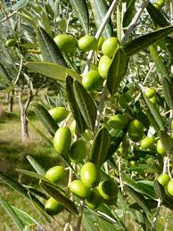
I am used for making oil rich in monounsaturated fatty acids and vitamin E. This oil is used as healthy fat.
Who am I?
OLIVE

Slide 9
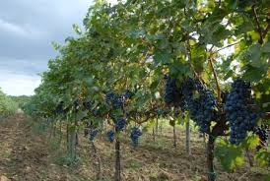
I am flowering plant. My fruit is tastefull grapes used for producting wine.
Who am I?
VINEYARD

Slide 10
6. If you think the sentence is true circle YES if you think it´s incorrect circle NO!
Lavander is a herb used on pizza.
YES/NO
b) Vipers are vanomous snakes.
YES/NO
c) Oregano keeps insects away
YES/NO
d) Immortelle produces essentials oils
YES/NO

Slide 11
7. CIRCLE THE CORRECT SENTENCE ABOUT DALMATIAN WALL LIZARD! ( two answers are correct)
Dalmatian wall lizard can be found on cliffs and rocks
It rips off its tail in case of emergency/danger
Its skin is covered in fur
Dalmatian wall lizard is often thought to be vanomous snake

Slide 12
8. Why are bees important for people and mindkind?
They are essential for the flow of energy throught the body´s food chain
They are important for the proces of photosynthesis
Bees pollinate flowers
They keep harmful insects away

Slide 13
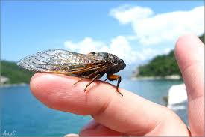
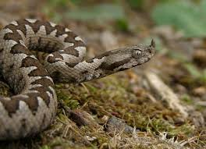
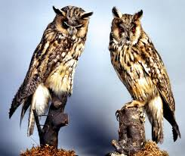
9. Match the pictures with the corresponding animal.
A
B
C
1. VIPER
2. EAGLE-OWL
3. CRICKET
A3
B1
C2

Slide 14
10. Circle the correct answer!
Hawk is...
A vulture
A raptor
A songbird
An insect

