Slide 1
PLANTS AND ANIMALS OF THE ADRIATIC COAST

Slide 2
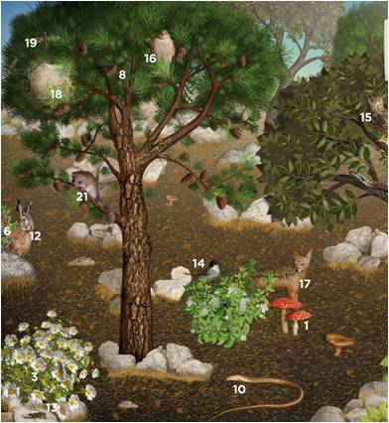
Mediterranean green forests developed on areas near by the sea
Winters are mild and rainy, without snow, and summers are hot and dry

Slide 3
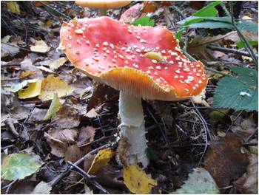
Plants and mushrooms in forest
GREEN PHALLOIDES
AMANITA MUSCARIA
Toxic
They live on wet ground

Slide 4
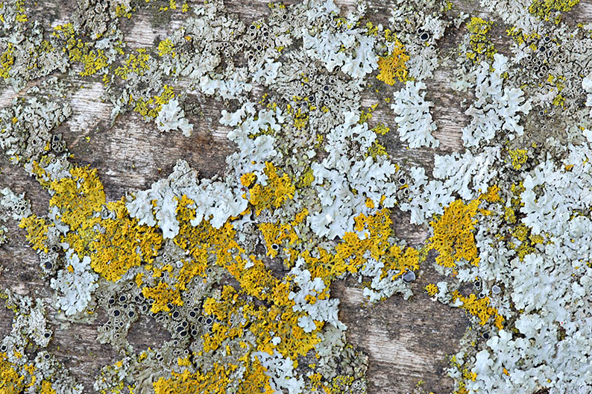
LICHEN
Community of seaweed and mushrooms
Habitat: trees, stone, ground
They can´t stand polluted air

Slide 5
TREE LAYERS
HOLM OAK TREE
ALEPPO PINE
DALMATIAN BLACK PINE

Slide 6
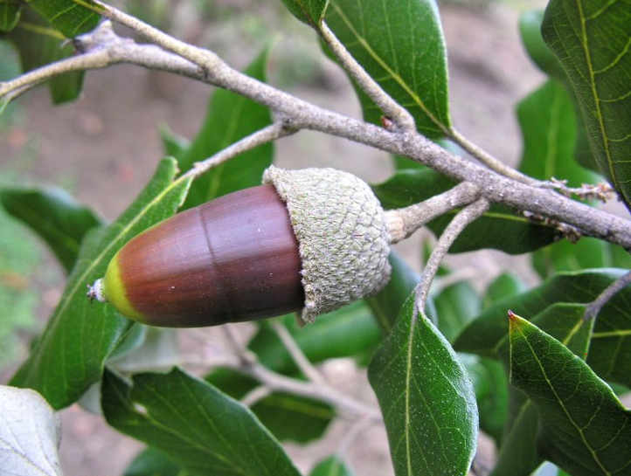
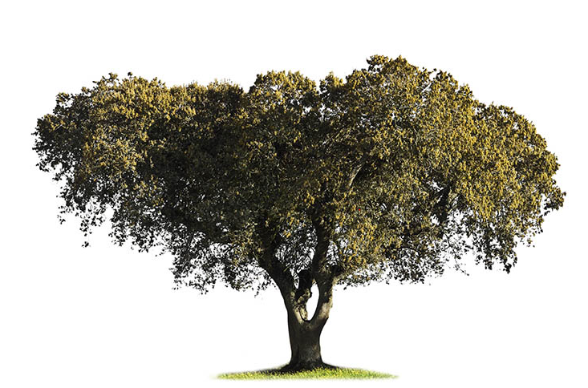
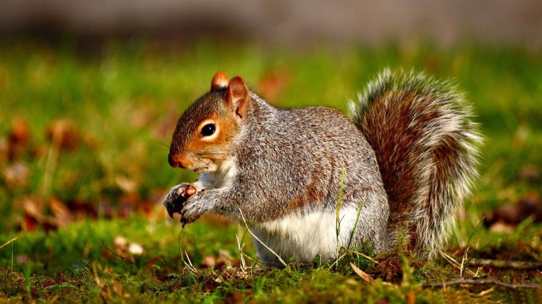
HOLM OAK TREE
- community of seaweed and mushrooms
- pollination by wind
Bloom : acorn
disperses by animals

Slide 7
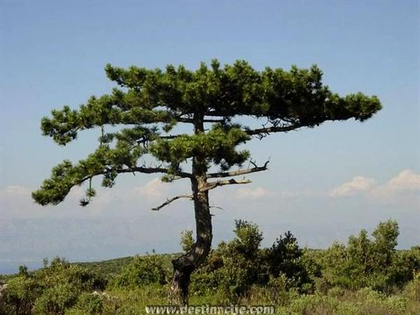
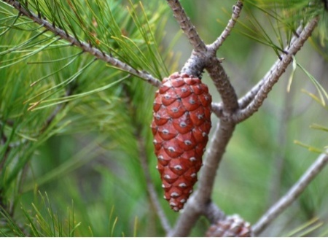
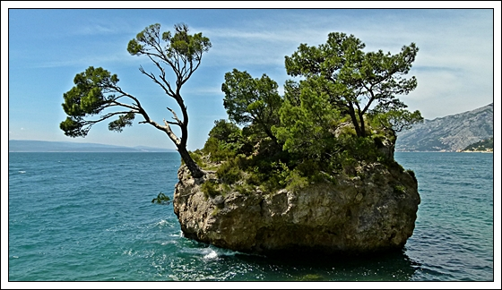
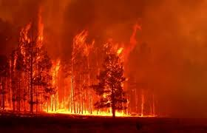
PINE
Needle leaves
Bloom : pine cone
pollination by wind
Due to hot summer months, pine becomes dry, explode and rapid wildfires occur

Slide 8
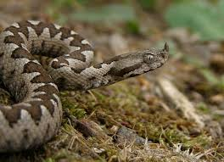
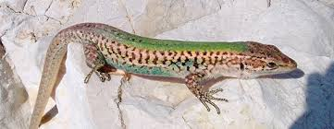
ANIMALS IN THE MEDITERRANEAN FORESTS
BOTTOM LAYER
VIPER
The most poisonous snake
DALMATIAN WALL LIZARD

Slide 9
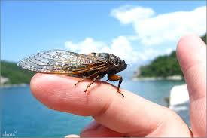
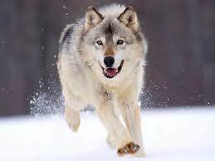
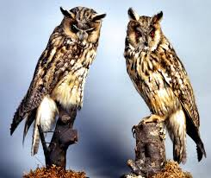
TOP LAYER

Slide 10
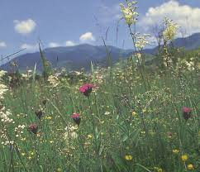
FLOWERS AND ANIMALS ON THE FIELDS

Slide 11
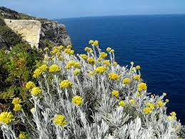
PLANTS
Immortelle
Immortelle
Oregano
Lavender
shrub, herbaceous plant
silver-gray, hairy leaves
bloom: yellow heads
produces essential oils

Slide 12
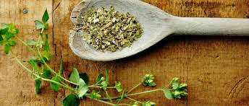
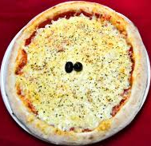
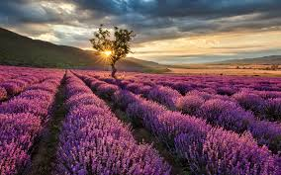
LAVENDER
OREGANO
blue violet blossom
pollinating insects are attracted to the color and nectar
scent soothes, relaxes and removes the feeling of tension
Oregano is a spice used in pizza
It is used as prepared tea, cure abdominal cramps and gastro-intestinal disease of the upper airways

Slide 13
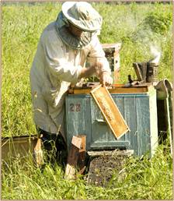
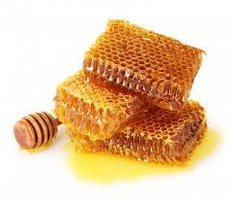
BEES
Bees pollinate plants
Benefit: honey, wax, propolis
Lives in community of hives

Slide 14
MALE
QUEEN
FEMALE BEES
- female lays 3000 eggs per day
care for cleanliness, feed the queen and baby bees
produce wax, build honeycombs and others
- fertilize female bees
Notes:
Jedna košnica može imati i do 30 000 jedinki.

Slide 15
HAWK
raptor
builds broad, shallow nests on cliffs or in trees

Slide 16
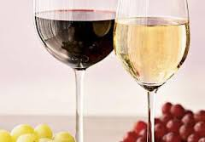
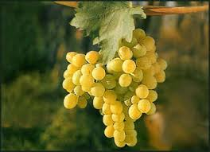
ECONOMICAL PLANTS
VINEYARDS
Vine is a flowering plant
Wine is produced from the grapes
Depending on the color of grapes is distinguished between red and white wine
In Istra, the most commonly grown are white and in Dalmatia red

Slide 17
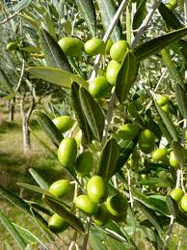
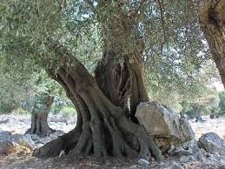
OLIVE
From olive fruit we get organic olive oil
Oil is used in cooking as a healthy fat
Olive oil is rich in unsaturated fatty acids and vitamin E
One of the most famous olive tree in Croatia is in the national park Brijuni , it´s age has been determined to be 1600 years old

Slide 18
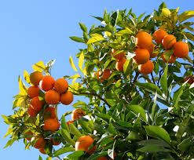
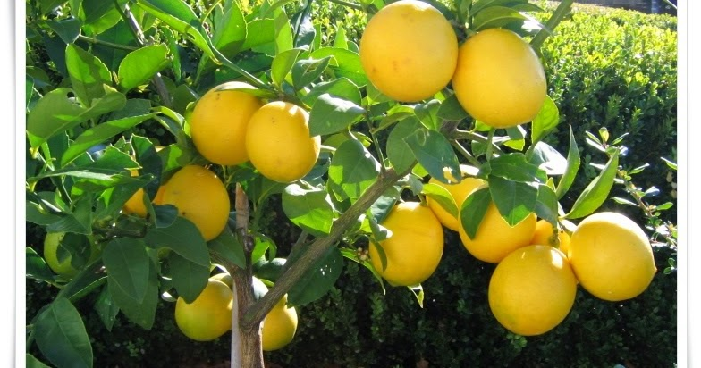
CITRUS FRUITS
Orange /Mandarine
Lemon
Grapes
Rich in vitamin C
Good for immune system
Low in calories

Slide 19
WE HOPE YOU ENJOYED OUR PRESENTATION AND NOW LET US SEE HOW MUCH YOU HAVE LEARNED.
PRODUCED BY: Lucija Mušac, Lucija Škarica and Jelena Mimica
Mentor: Ivana Zemunik

