Slide 1
The Great Wall of China
A presentation made by toni srdanoviĆ

Slide 2
About the wall:
The Great Wall of China traditional Chinese: 萬里長城; simplified Chinese: 万里长城; pinyin: Wànlǐ Chángchéng is a series of fortifications that were built across the historical northern borders of ancient Chinese states and Imperial China as protection against various nomadic groups from the Eurasian Steppe.

Slide 3
FUN FACTS:
Apart from defense, other purposes of the Great Wall have included border controls, allowing the imposition of duties on goods transported along the Silk Road regulation . Furthermore, the defensive characteristics of the Great Wall were enhanced by the construction of watchtowers, troop barracks, garrison stations, signaling capabilities through the means of smoke or fire, and the fact that the path of the Great Wall also served as a transportation corridor. encouragement of trade and the control of immigration and emigration.

Slide 4
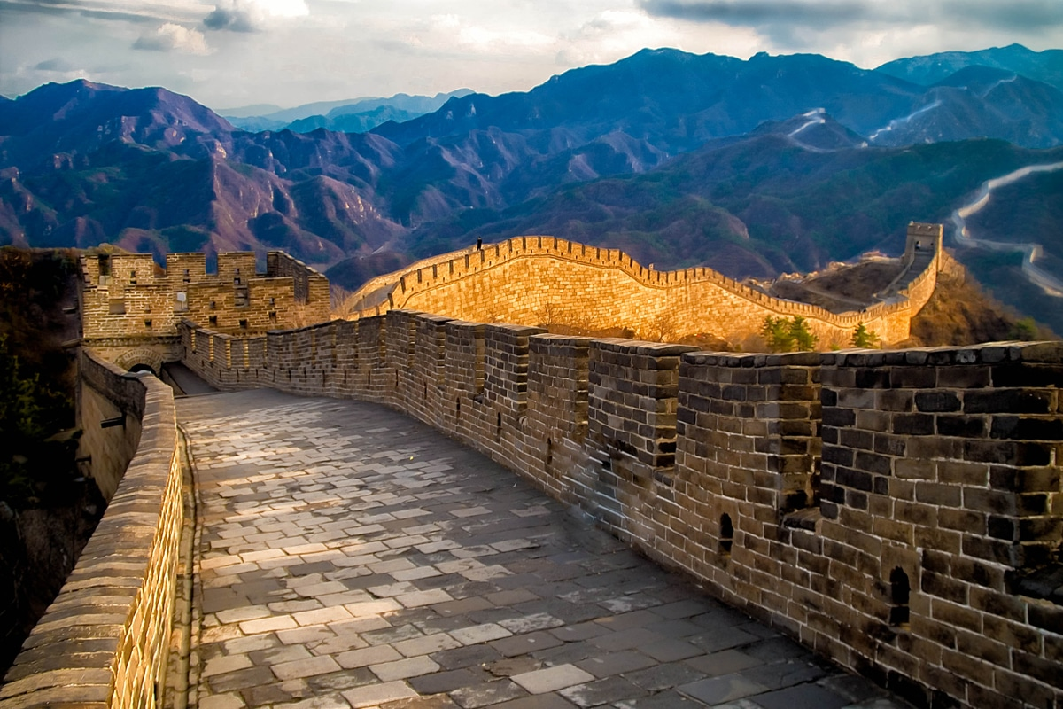
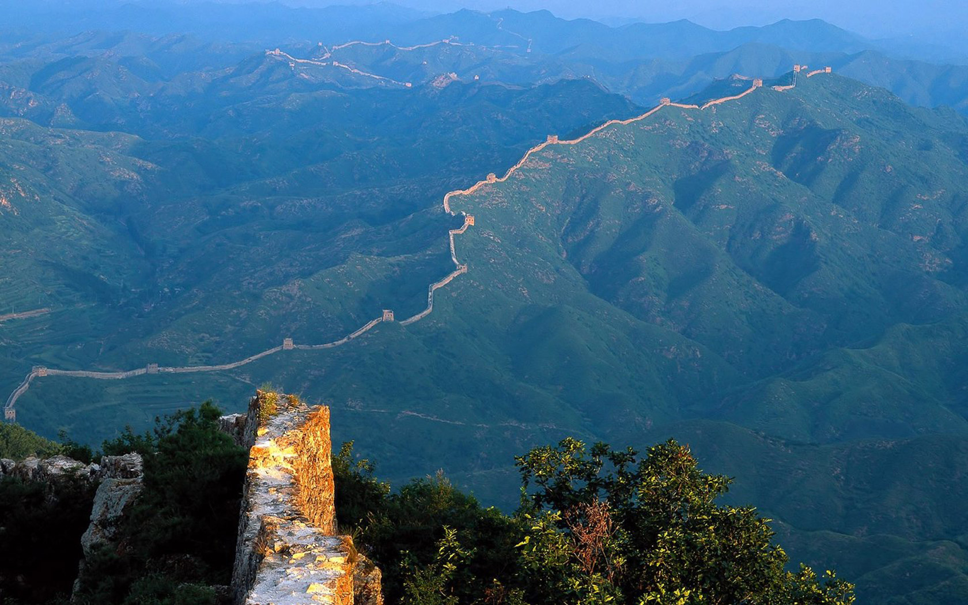
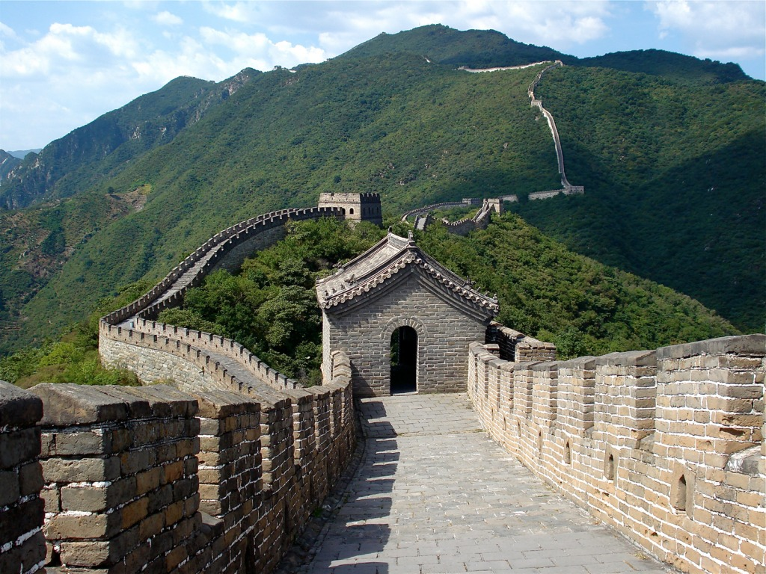
PICTURES:

Slide 5
How old is the wall
Several walls . The most well-known sections of the wall were built by the Ming dynasty (1368–1644). were built from as early as the 7th century

Slide 6
I hope you enjoyed

